Slide 1
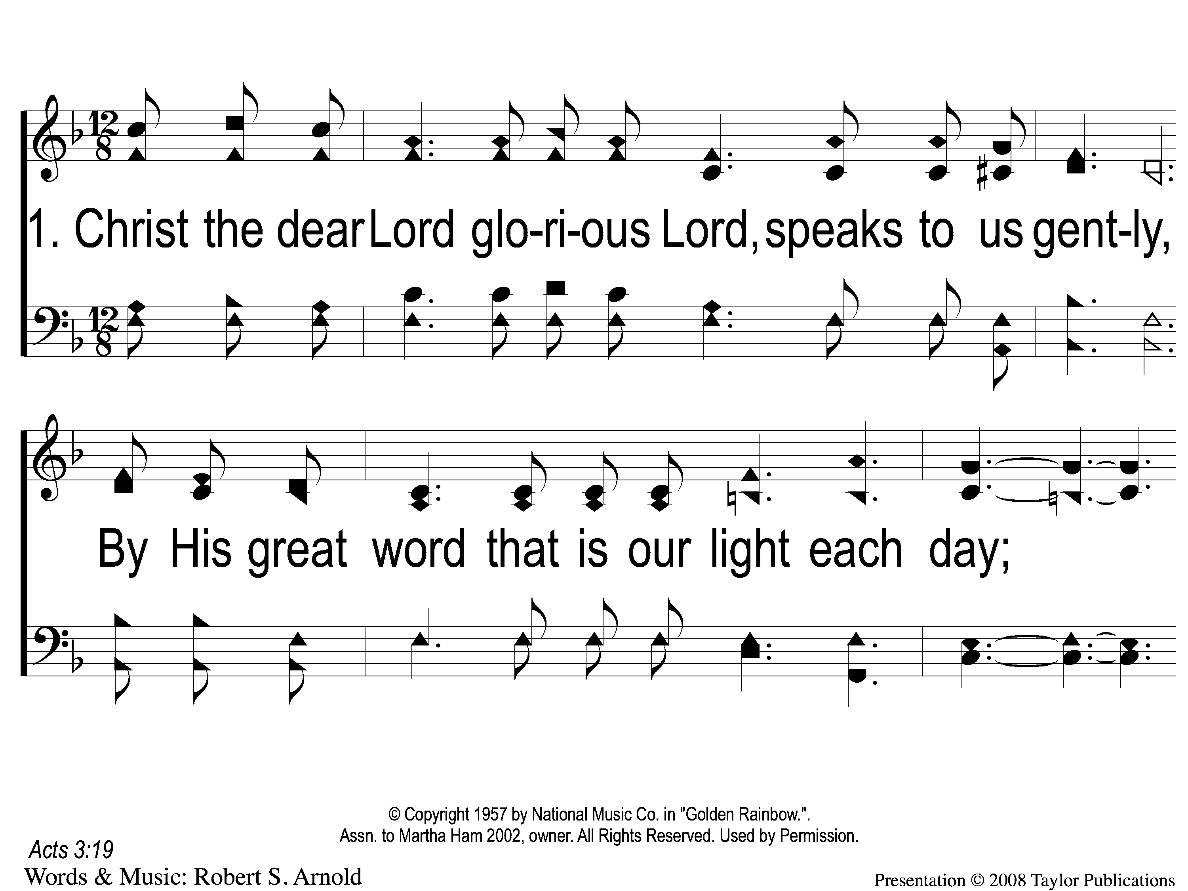
1-1 Did You Repent
Did You Repent
82

Slide 2
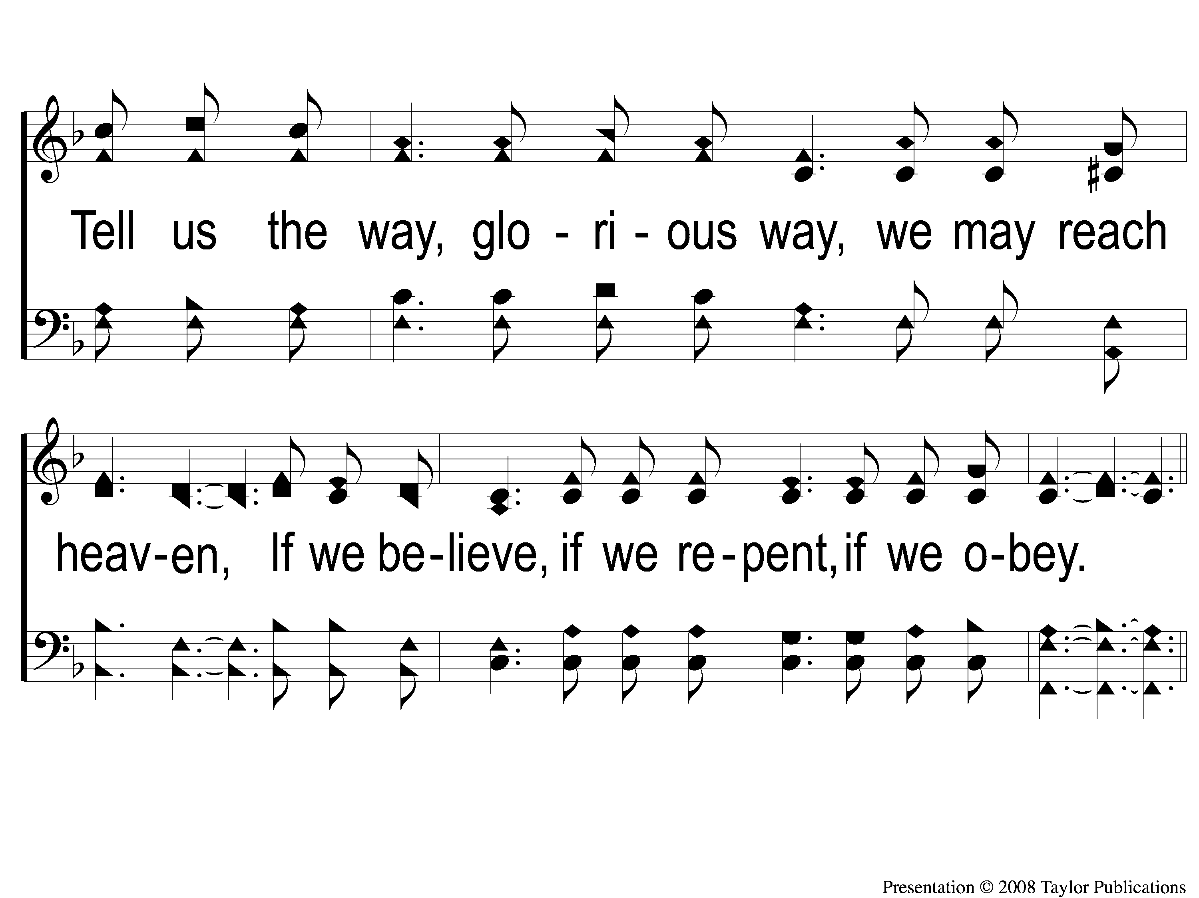
1-2 Did You Repent
Did You Repent
82

Slide 3
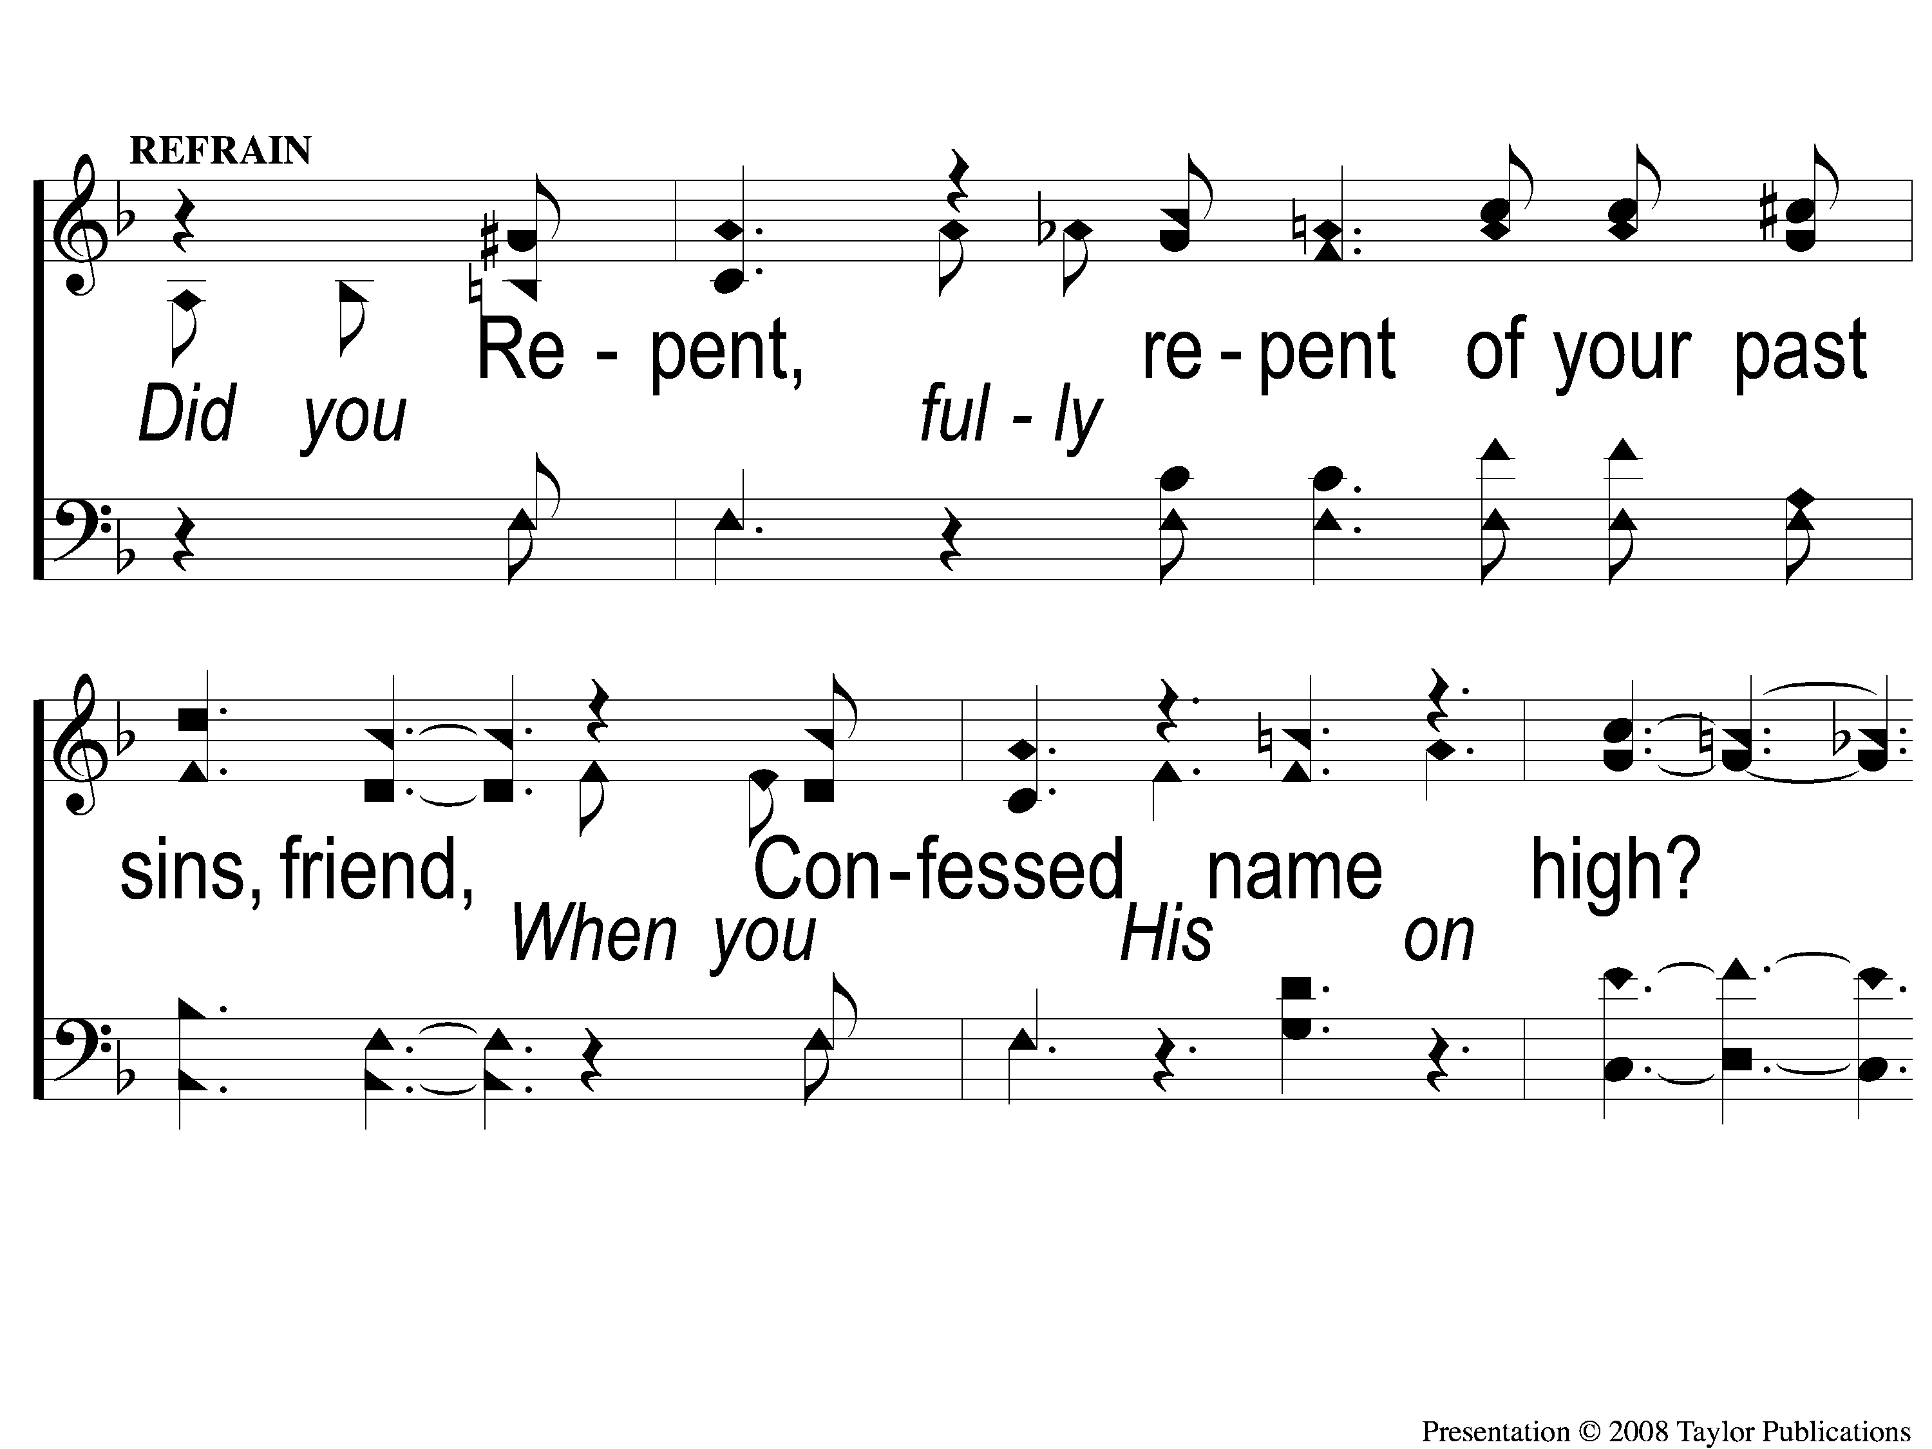
C-1 Did You Repent
Did You Repent
82

Slide 4
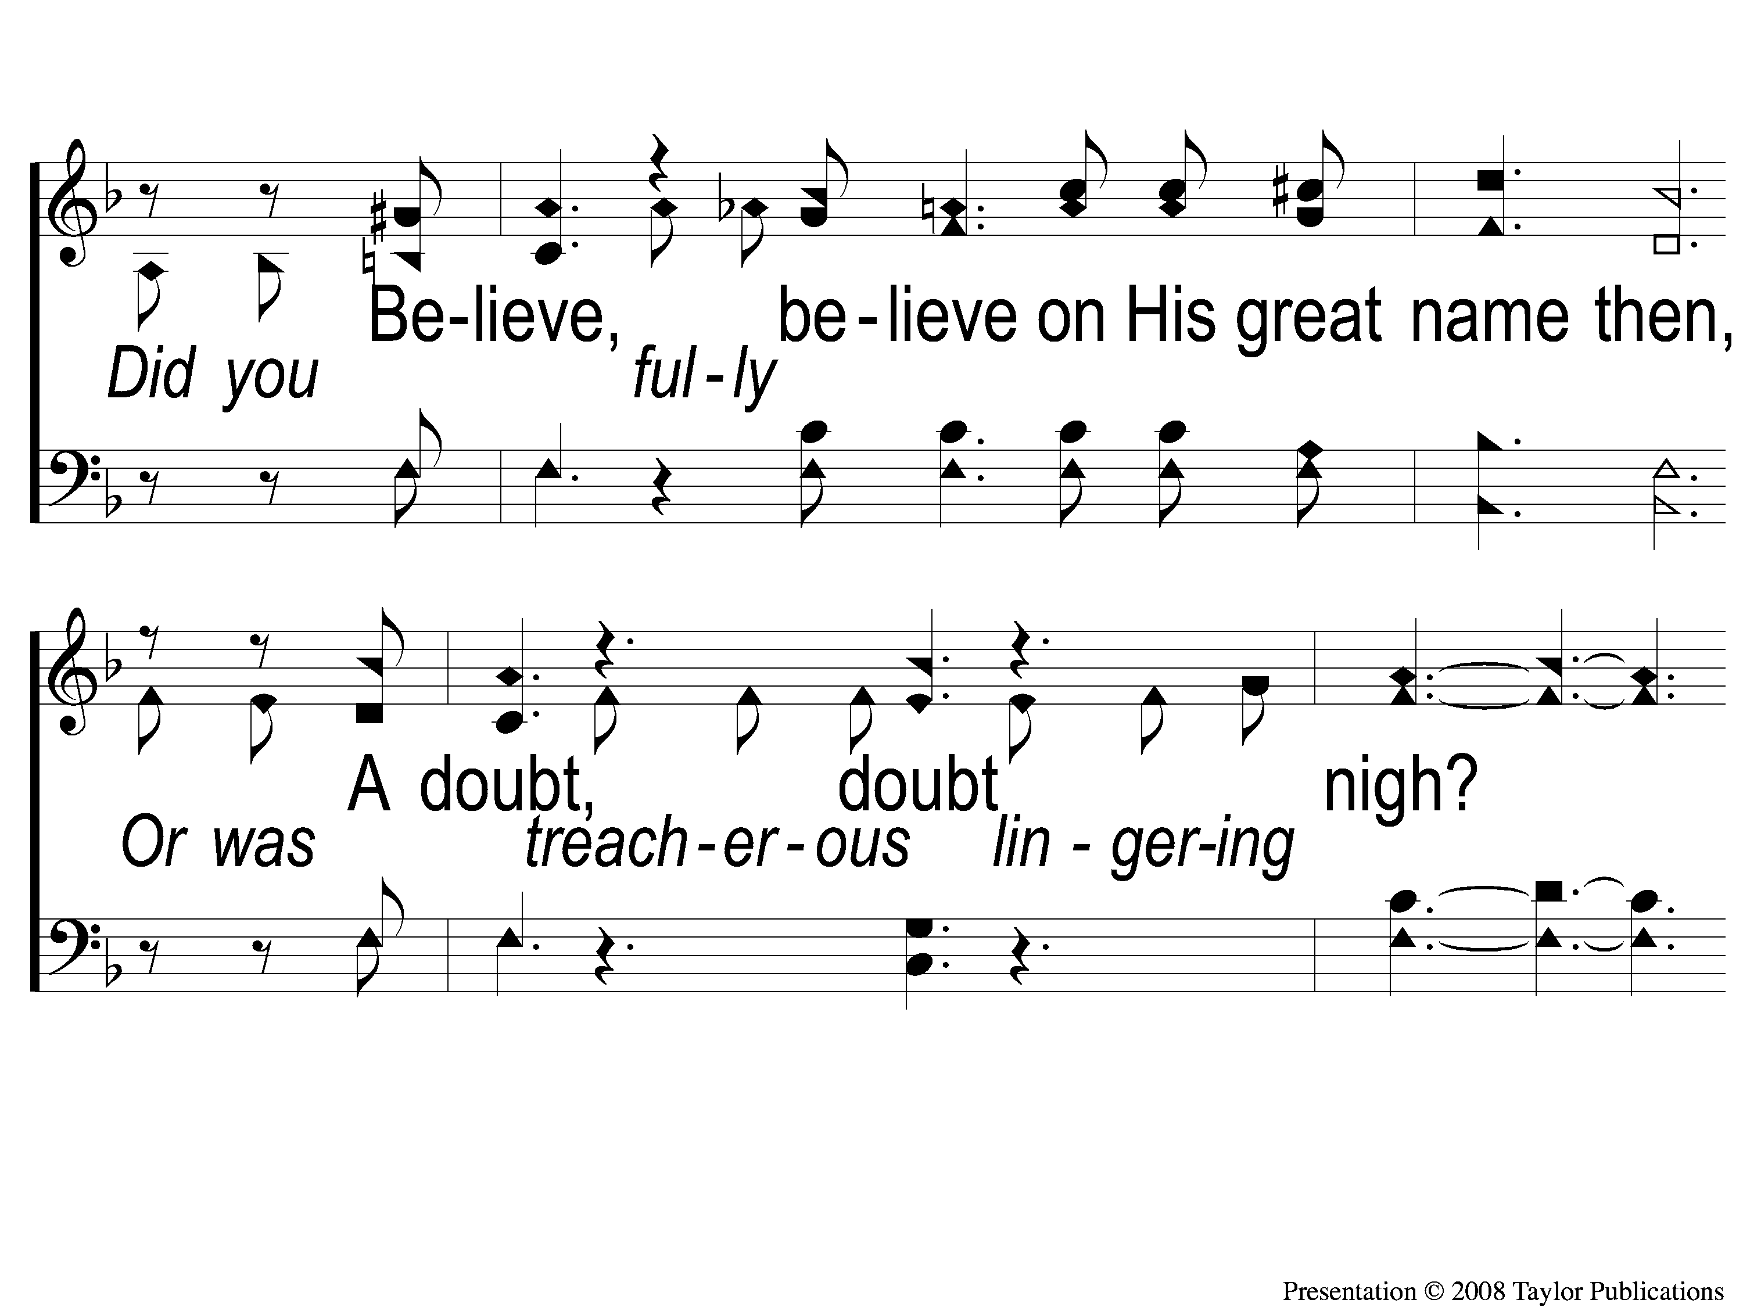
C-2 Did You Repent
Did You Repent
82

Slide 5
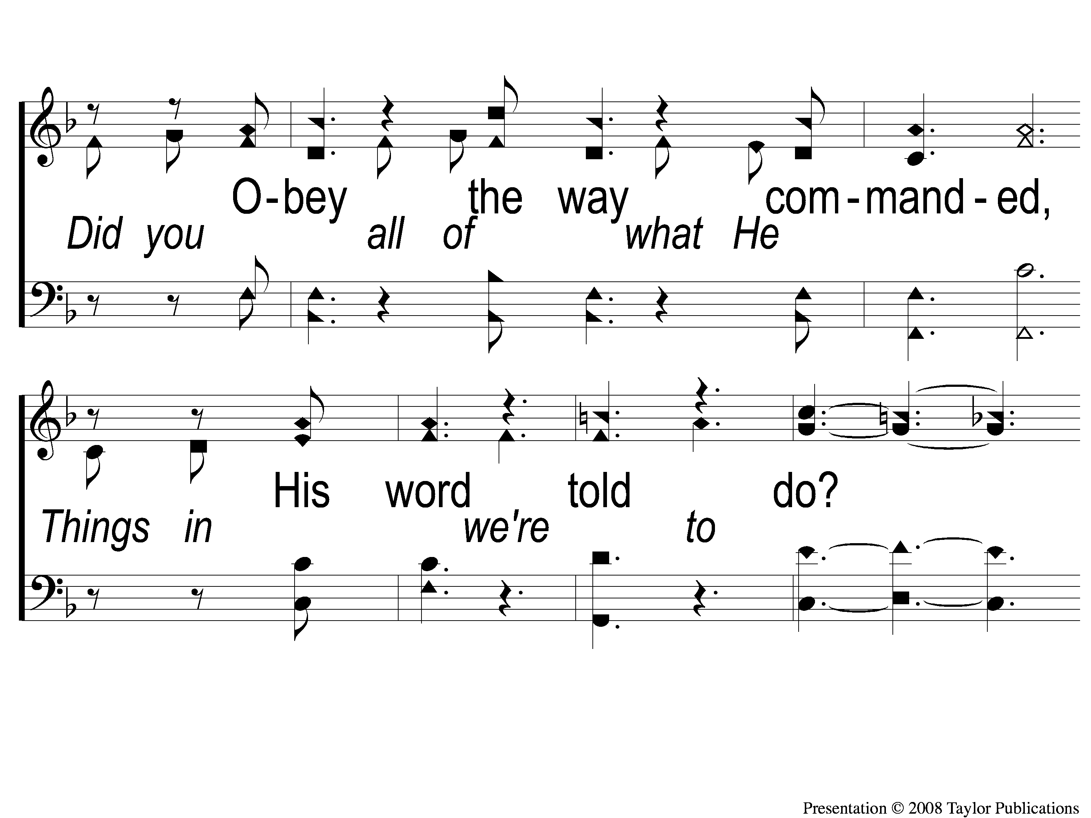
C-3 Did You Repent
Did You Repent
82

Slide 6
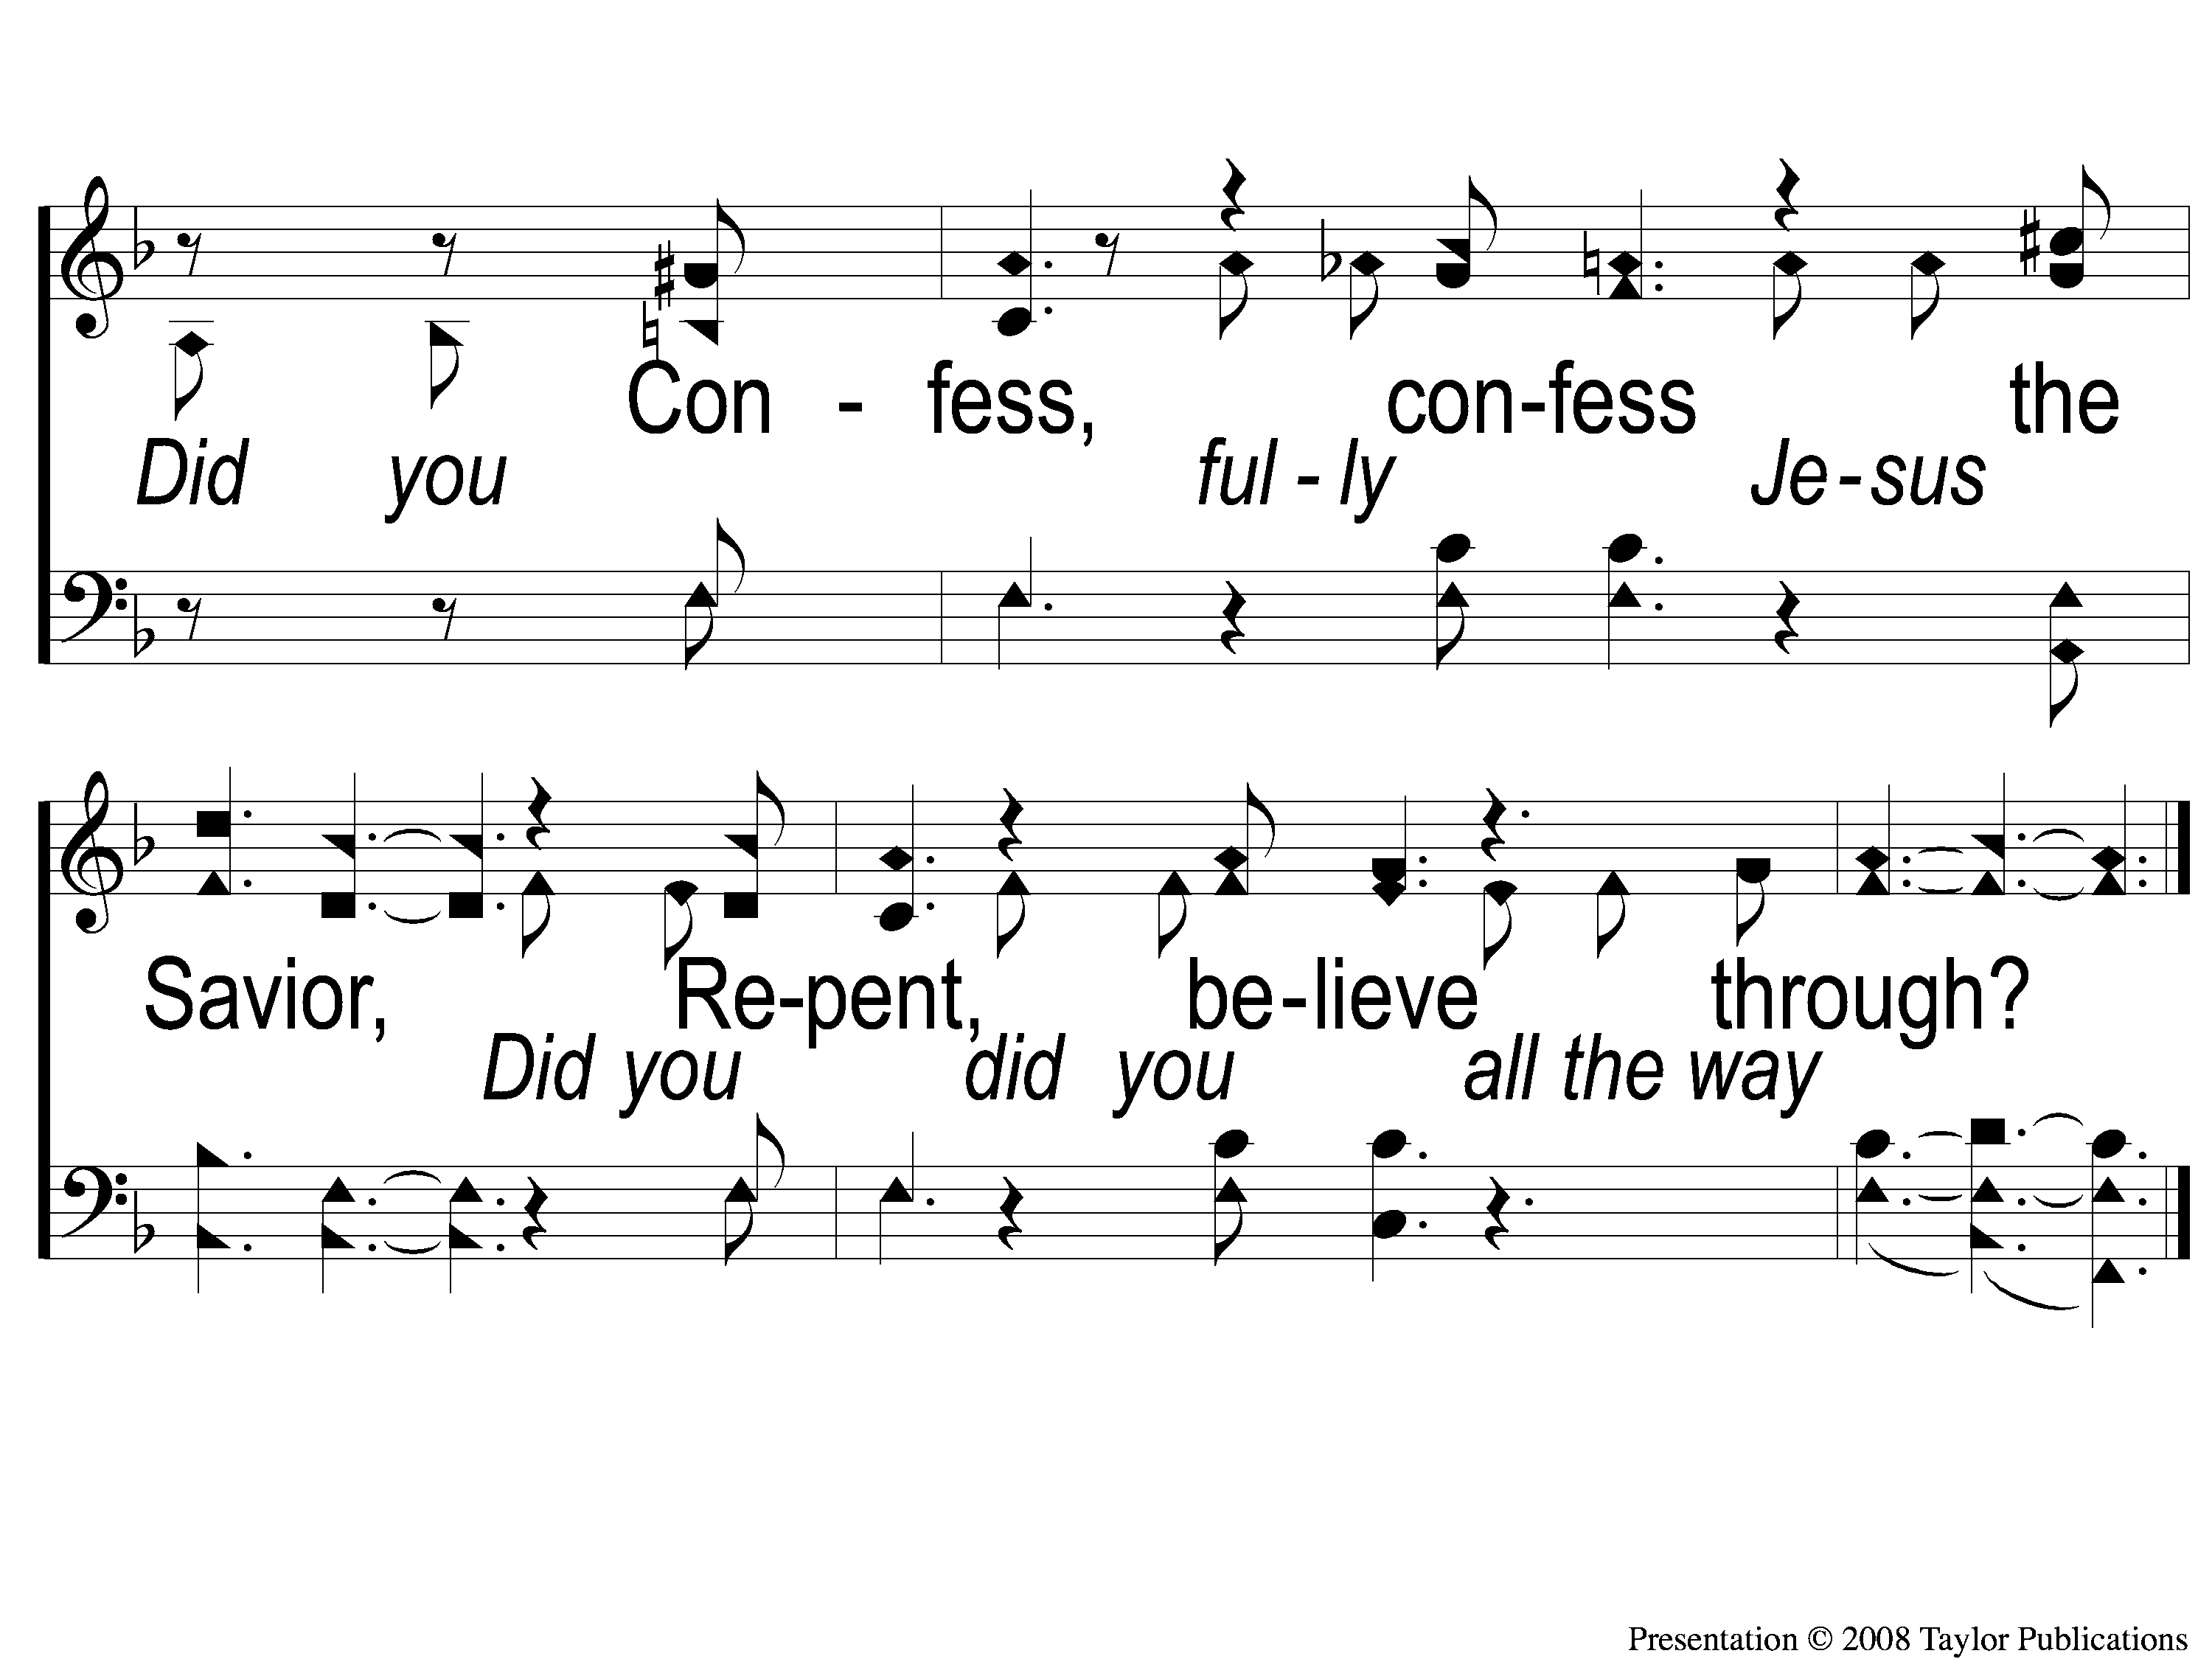
C-4 Did You Repent
Did You Repent
82

Slide 7
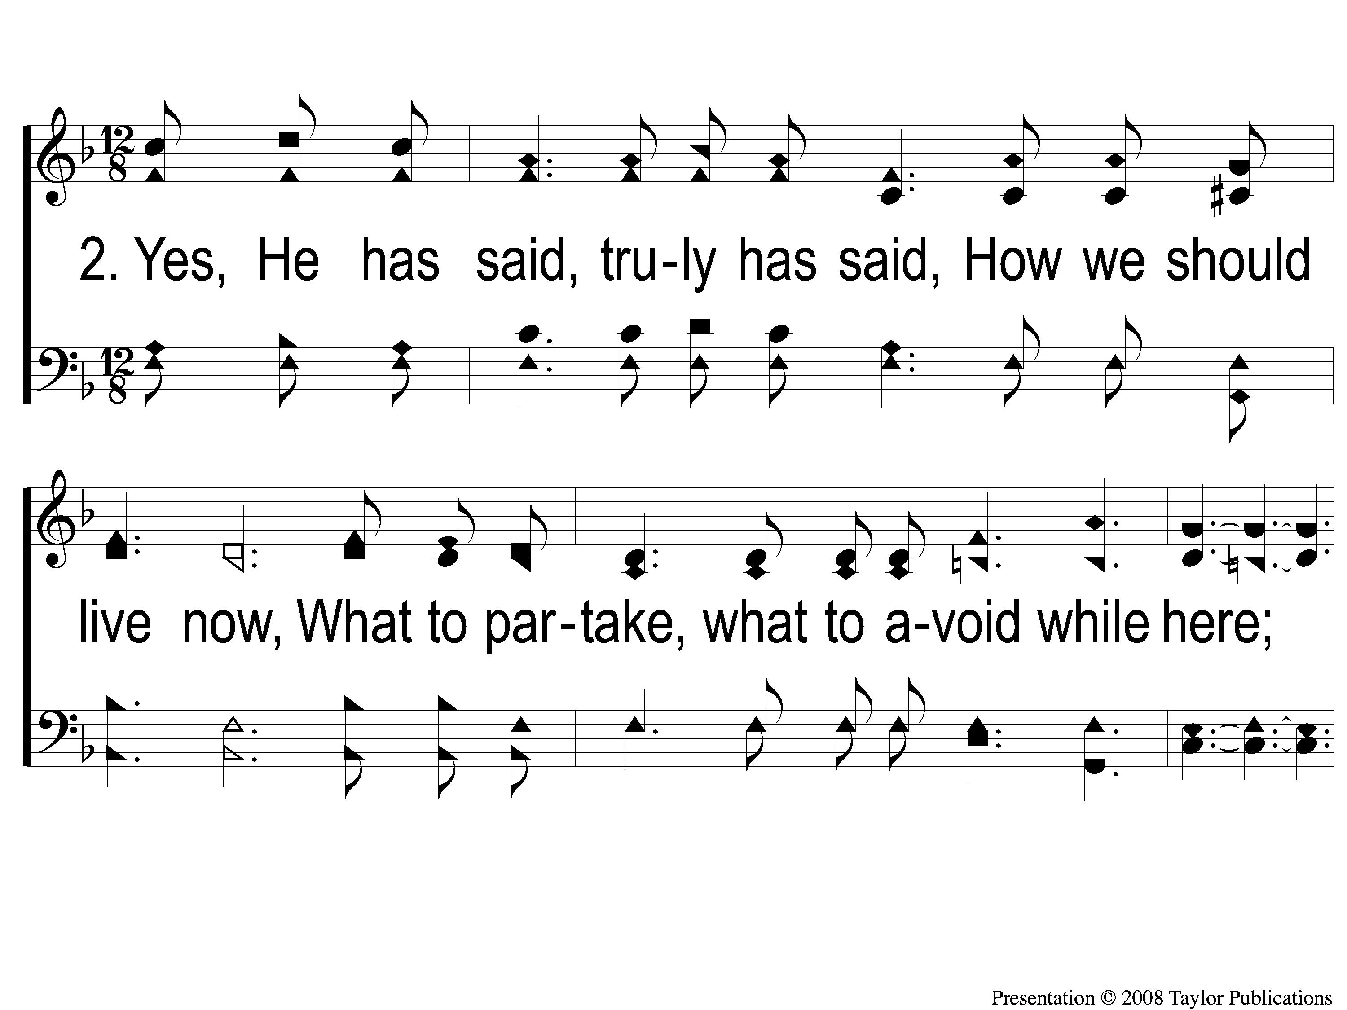
2-1 Did You Repent
Did You Repent
82

Slide 8
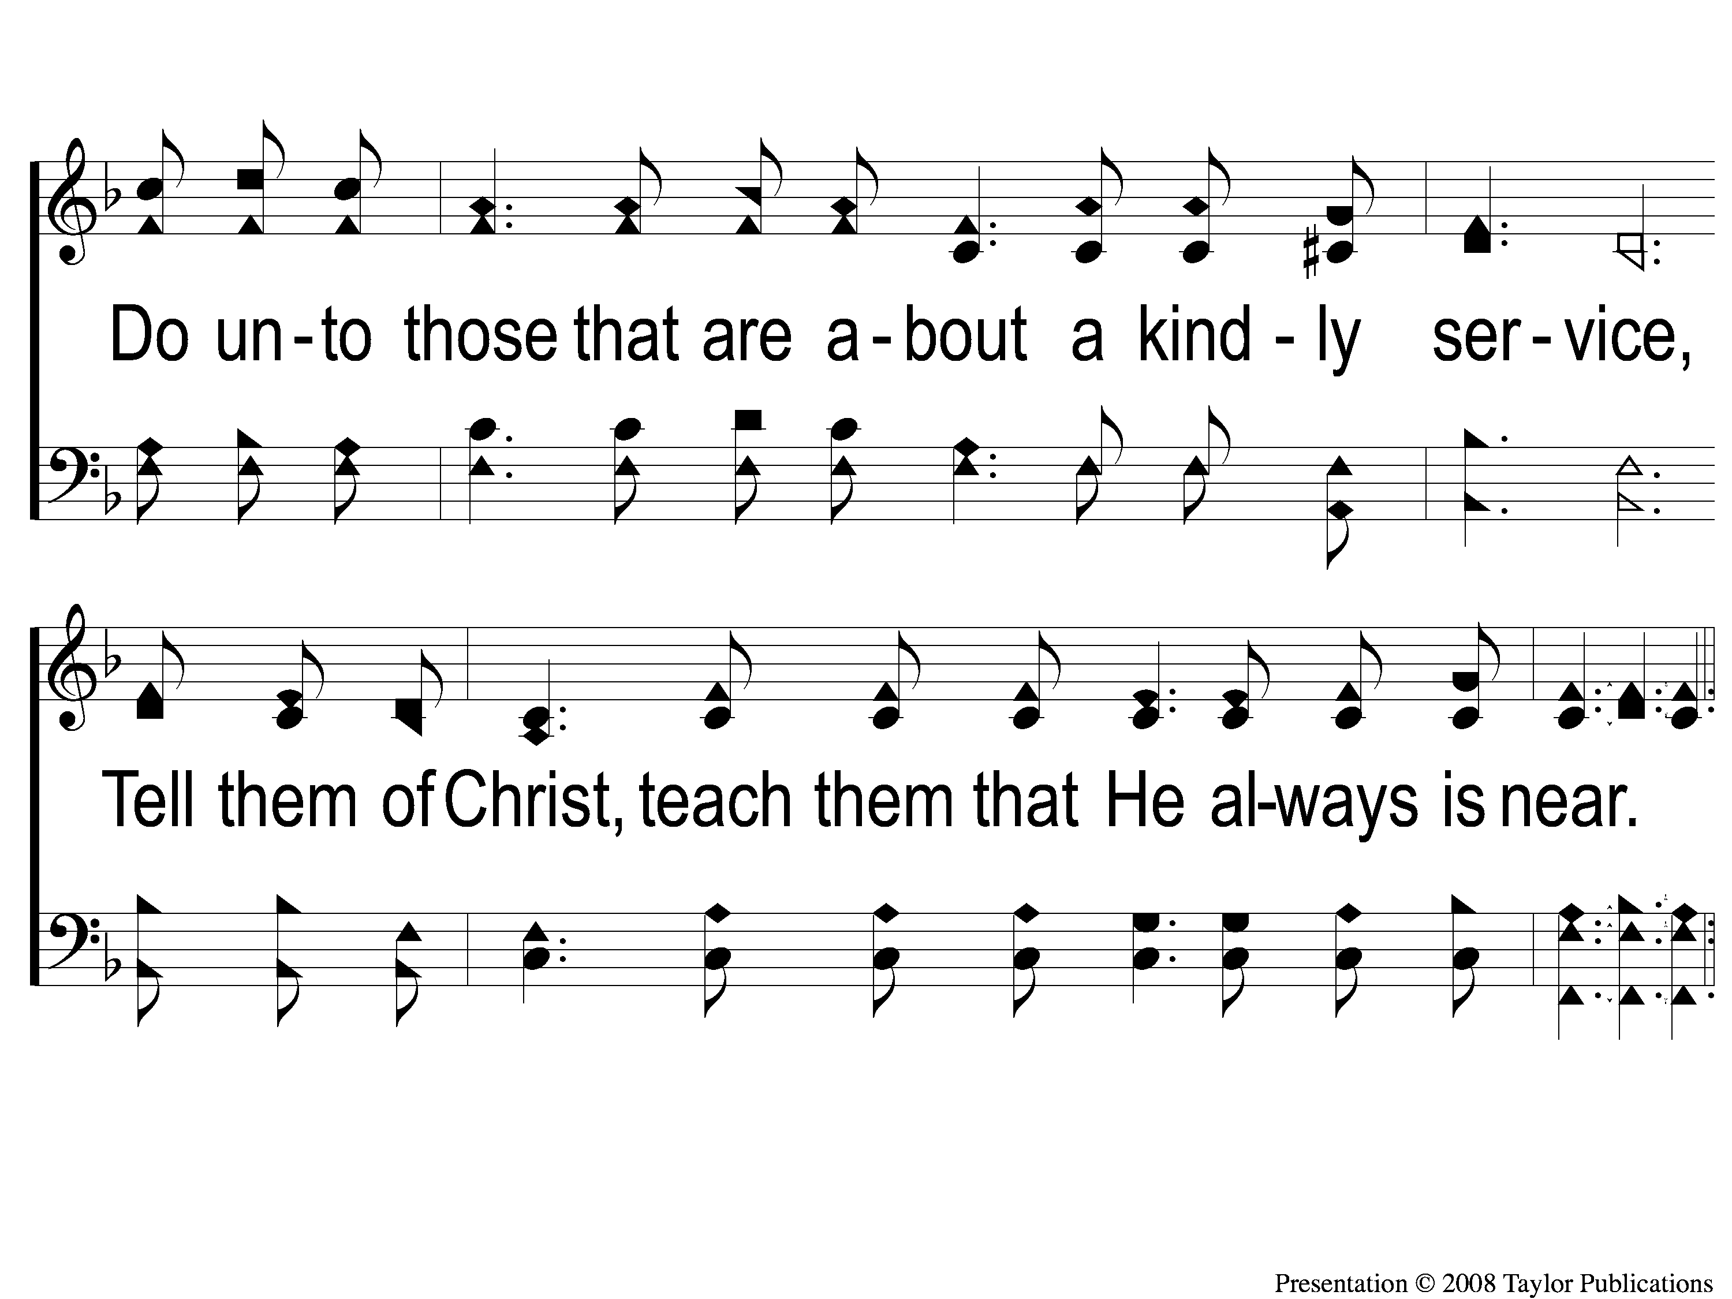
2-2 Did You Repent
Did You Repent
82

Slide 9
C-1 Did You Repent
Did You Repent
82

Slide 10
C-2 Did You Repent
Did You Repent
82

Slide 11
C-3 Did You Repent
Did You Repent
82

Slide 12
C-4 Did You Repent
Did You Repent
82

